Slide 1
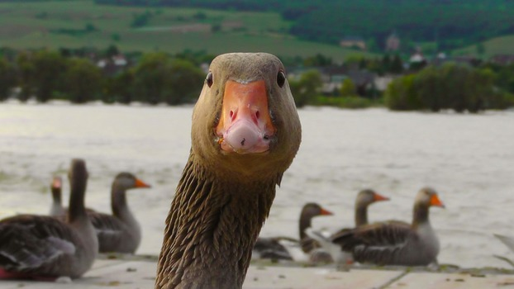
36” x 60” Poster Template with Tips
CSUF Faculty Development Center
Using This Template
Everything in this template is editable! You can change colors, change font styles and sizes, resize areas by dragging, add a column by inserting a new Text Box, and delete an existing Text Box column.
To save you time, we have used a recommended layout and recommended font sizes for headings and body.
Please feel free to use this template, especially when you need a poster at the last minute, when a student needs a poster, or if the FDC’s existing poster workload from other faculty requests prevents us from taking on additional faculty jobs with little turnaround time.
Reader-Friendly Layout Tips
Create your poster with your reader in mind! Follow these tips:
Everything should big enough to read from 3 to 6 feet away.
Your audience should be able to read the text in 5-10 minutes.
Summarize your research to reduce the amount of text.
Organize your content so someone can read by moving from left to right without having to move back to the left side.
Keep your layout simple and uncluttered.
Changing the Layout
When changing the poster’s layout, do not click “Layout” like you do for a PowerPoint presentation. Instead, to add a new area for textual content, click Insert and then Text Box. Drag to resize the text boxes. The height of each box will expand and contract as you add and remove text. To make room for an image, you can either add blank line spaces in the middle of one large text box (like we did in the middle text box) and drag the image where you want it, or use a smaller text box (like on the right) and place the image outside the text box.
Click View and check Gridlines to see if text boxes are aligned in height.
Title Tips
Use 100-point font or larger for the poster title and author(s).
Use a mix of upper- and lower-case letters (Headline style) for your title like we did in this template. All caps are more difficult to read.
Heading Tips
Use 36-point font or larger for headings.
Mix upper- and lower-case letters; all caps are harder to read.
Body Text Tips
Use 28-point font or larger.
Use a simple font: Calibri, Arial, Cambria, Times New Roman, etc..
Want to tweak the space between lines of text (between headings and body, or in a bulleted list)? Click Home, then Paragraph, then modify the Spacing Before or After specific lines of text.
Faculty Posters Requested by College for AY 2015-16
Graphics
Graphics break up text, convey data, and emphasize main points.
Click Insert → Chart to insert a pie chart, bar chart, etc.
Click Insert → Smart Art to quickly add color and variety while emphasizing main points, processes, or relationships. Example →
Print at 200%
Power Point limits the size to 56 inches. In order to get a larger width this poster is sized 18 x 30 inches. It will then be printed at 200% to achieve a 36x60 inch poster.
Logos
Choose from 2 CSUF logos above. Be sure to hold the shift key while resizing so the logo will not stretch out of proportion.
Free Images
Images capture readers’ attention! Here are some sources for free ones:
https://unsplash.com
https://www.pexels.com
https://stocksnap.io
http://picography.co
Insert SmartArt
Processes
Type Your Text
Text areas are already set up
Change Colors
Use a preset color scheme
Hierarchies
Relationships
Or right-click & change Shape Fill

