Slide 1
Supporting Students and Promoting Social Justice with Innovative & Equitable Pedagogy: Purposeful Modifications in an Asynchronous Course (EDEL 543: Critical Arts Education w/in Urban Communities)
FEID Grant
Rohanna Ylagan-Nicanor

Slide 2
Based on Fall 2023 Course
Fall 2023 Data
Identified Needs
Objectives
● to provide clearer, more engaging assignments for students to reflect on their own privileges and biases
● to incorporate high-impact practices that involve a range of technologies and activities to promote students’ learning
● to provide clearer instructions (including examples vs non-examples) using high-impact practices for students to successfully create culturally and linguistically responsive arts education, including anti-bias curriculum
student opinion questionnaires (SOQs)
observations, grading
mid-semester check-in (Padlet)
student success dashboards
support in opportunities to examine their own privileges and biases
opportunities that involve a range of technologies and activities to promote their learning
clarity of assignments, expectations, and information presentation

Slide 3
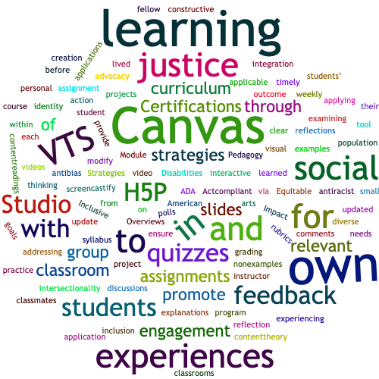
Instructional Improvement
Methods & Activities

Slide 4
HIGH IMPACT PRACTICES | METHODS & ACTIVITIES
High level performance expectations | update grading rubrics, quizzes, syllabus provide project examples & non examples, clear explanations
Significant student engagement (by investment of time, effort) | engagement with content/readings, small group, instructor (through H5P, Canvas Studio, VTS) engagement in relevant, updated assignments
Meaningful, substantive learning interactions with faculty, staff, students, or external entities | Canvas learning experiences (H5P videos, quizzes, VTS, Canvas Studio) small group discussions, reflections, projects feedback comments
Experiences with diversity, complexity, change | applicable learning experiences with own classroom students (multicultural, BIPOC, dis/ability) addressing: social justice learning outcome of program social justice advocacy, action needs of own students and examining intersectionality, identity
Frequent, meaningful feedback | weekly feedback within Canvas timely constructive feedback for each assignment
Reflective, integrated learning | relevant applications to own classroom reflection on own lived experiences arts integration to promote social justice, curriculum goals, tool for inclusion
Experiential learning | earning through applying content/theory to practice in own classrooms personal learning and students’ learning experiences experiencing VTS in course with fellow classmates before creation and application for their own students

